Slide 1
Image Formation
Computer Vision

Slide 2
Computer Vision Image Formation

Slide 3
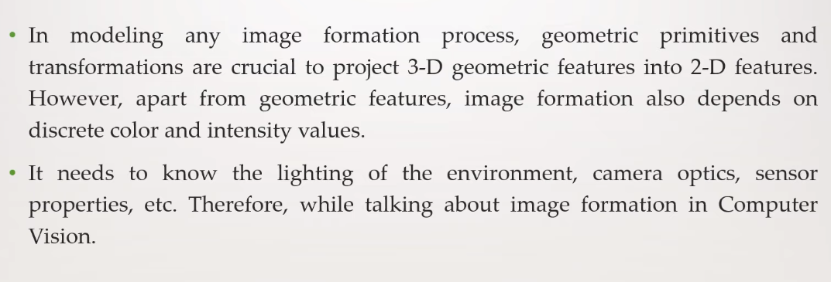
Image Formation

Slide 4
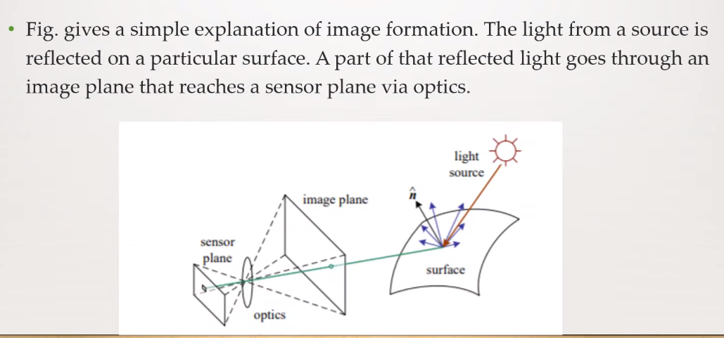
Photometric Image Formation

Slide 5
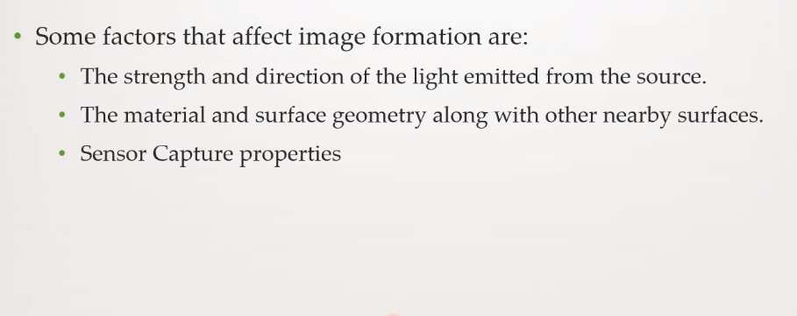
Photometric Image Formation

Slide 6
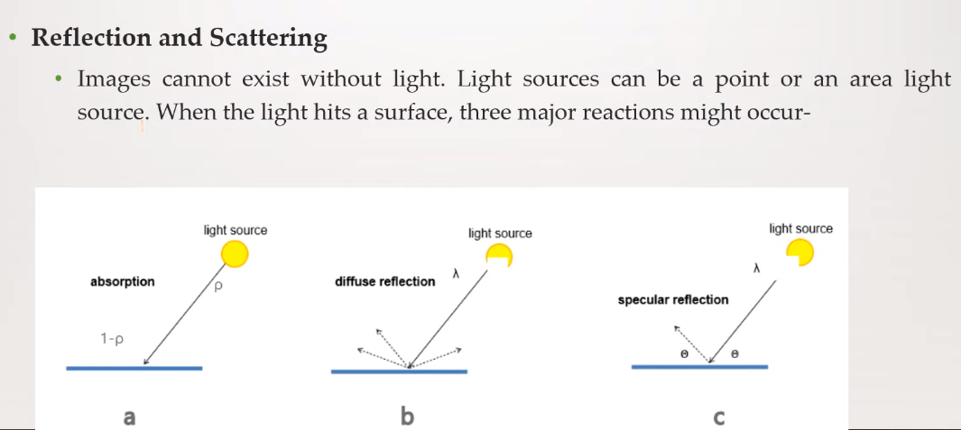
Photometric Image Formation

Slide 7
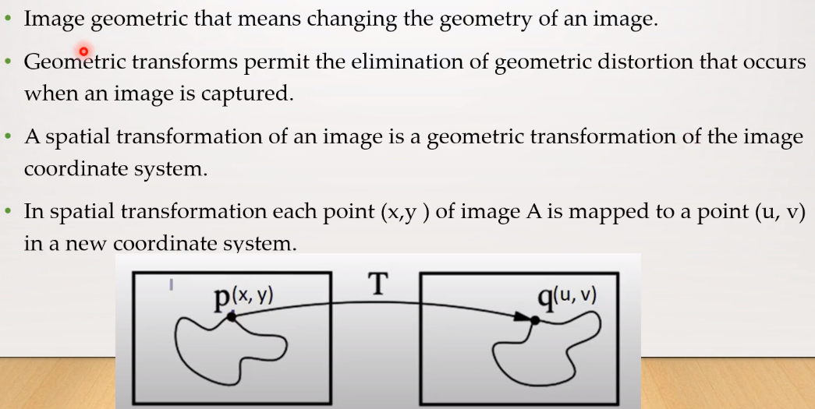
Image Geometric Transformation

Slide 8
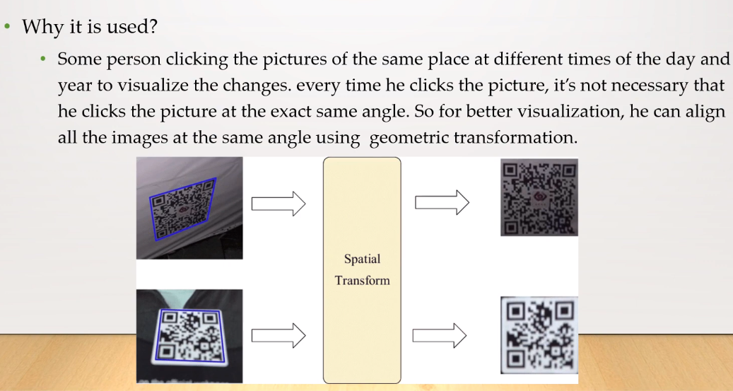
Image Geometric Transformation

Slide 9
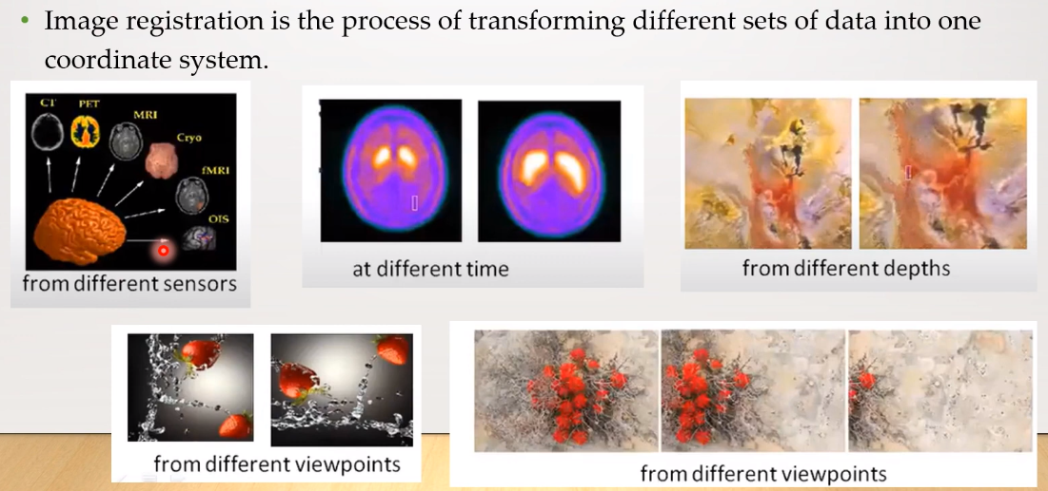
Image Geometric Transformation

Slide 10
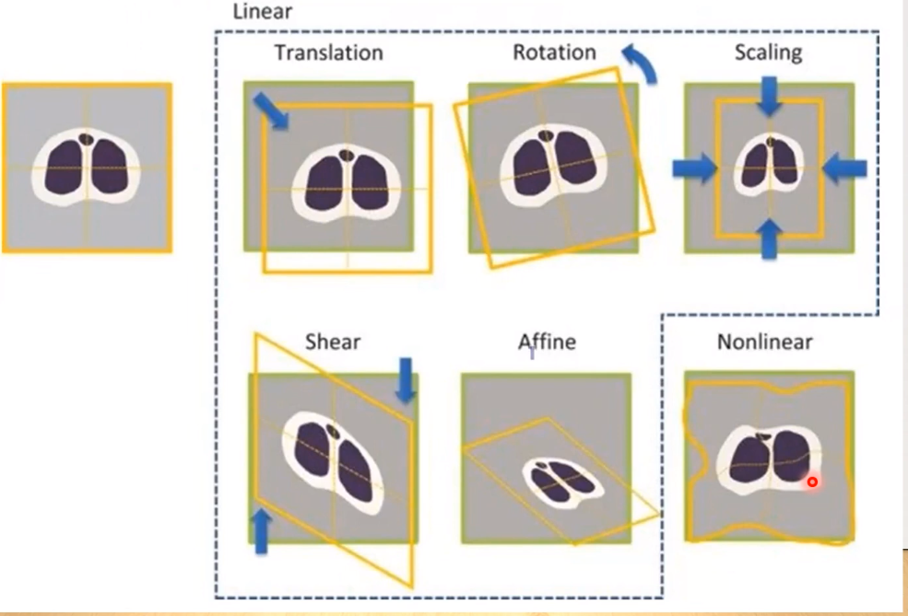
Types of Geometric Transformations

Slide 11
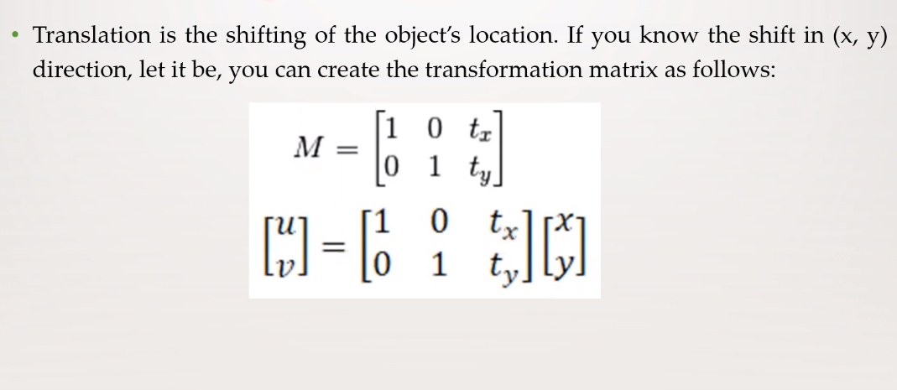
Translation

Slide 12
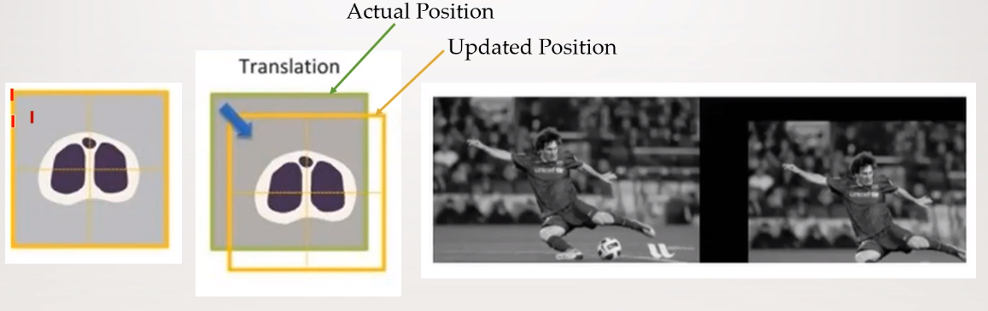
Translation

Slide 13
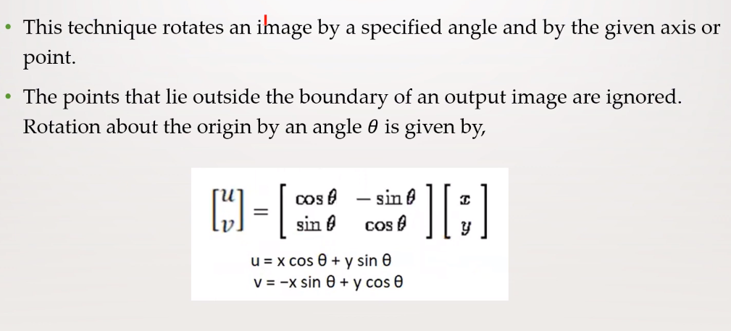
Rotation

Slide 14
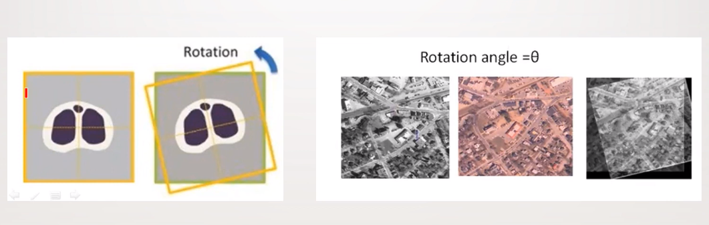
Rotation

Slide 15
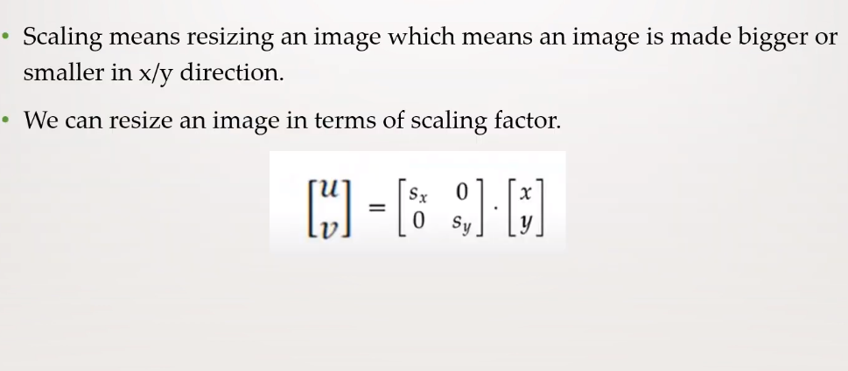
Scaling

Slide 16
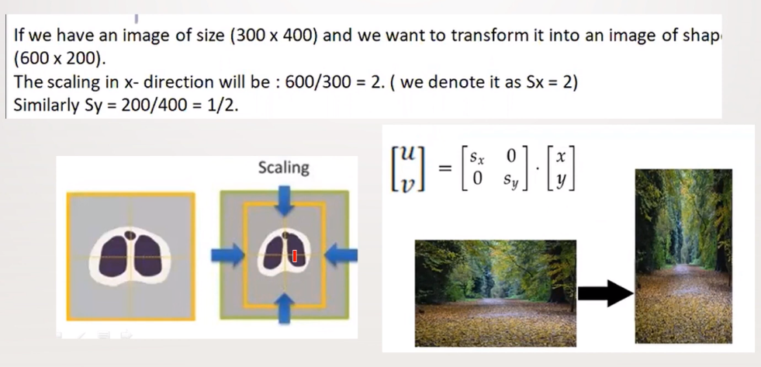
Scaling

Slide 17
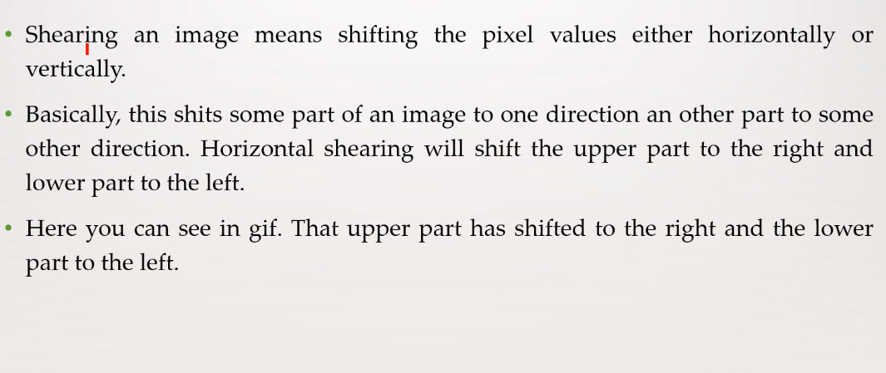
Shearing

Slide 18
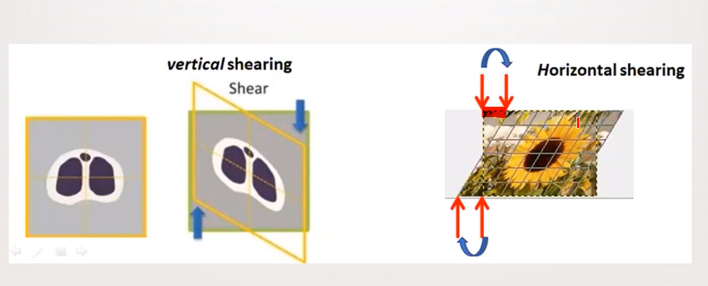
Shearing

Slide 19
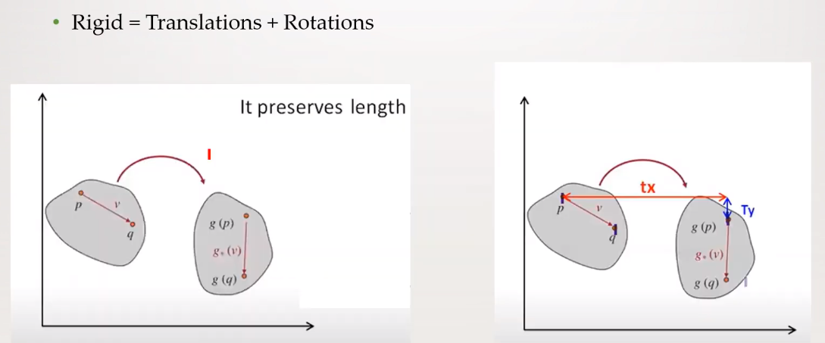
Rigid Transformation

Slide 20
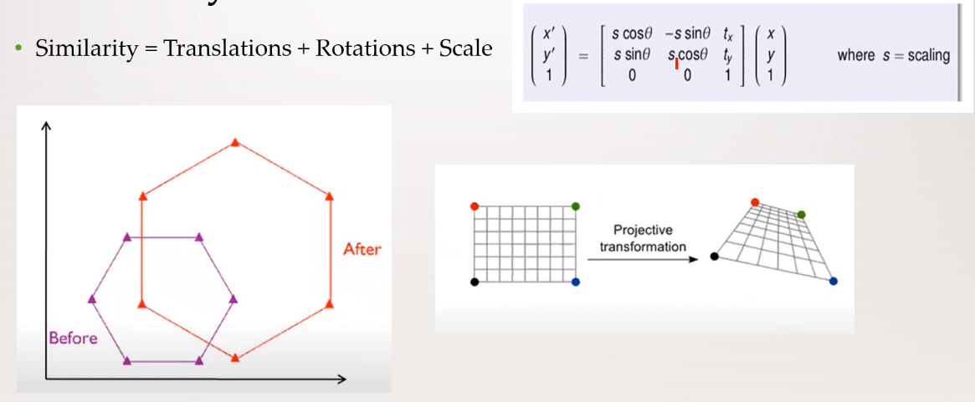
Similarity Transformation

Slide 21
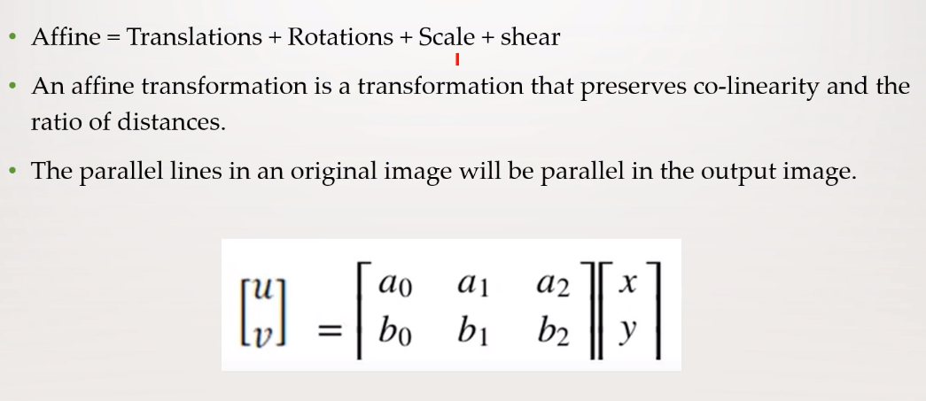
Affine Transformation

Slide 22
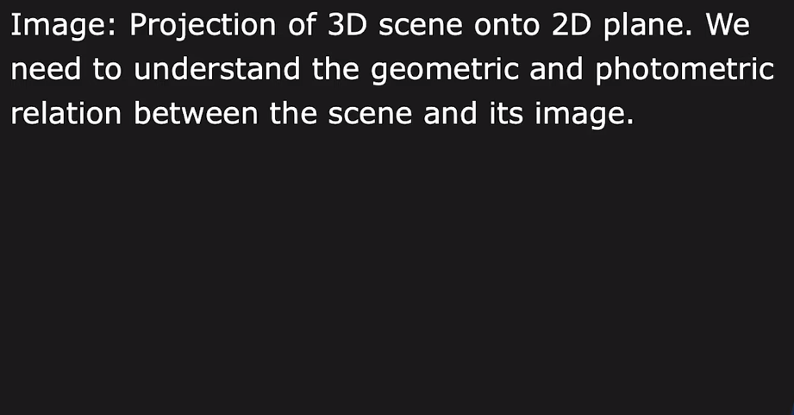
Image Formation

Slide 23
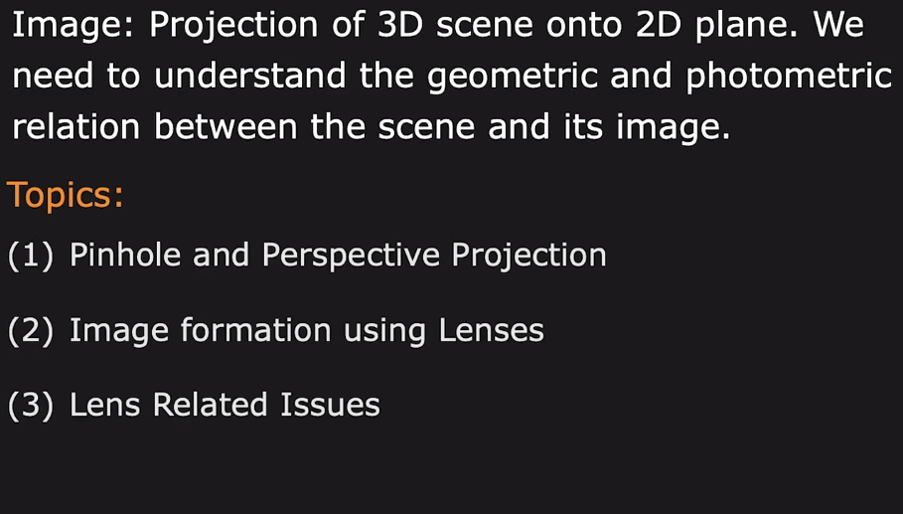
Image Formation

Slide 24
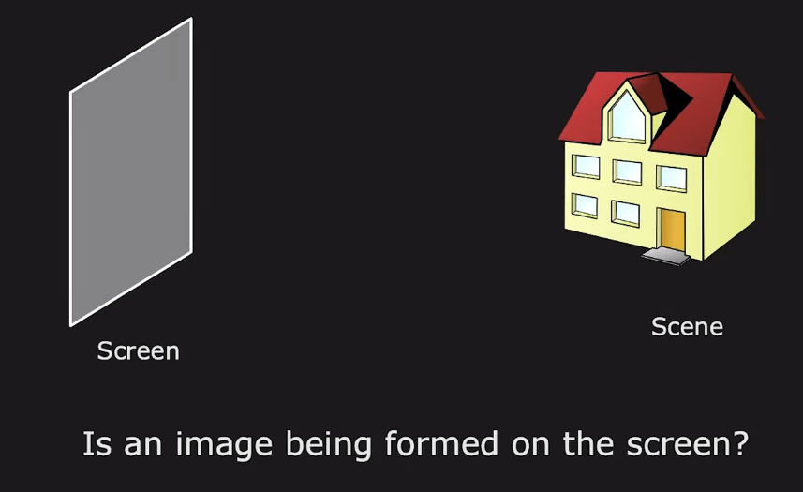
Image Formation

Slide 25
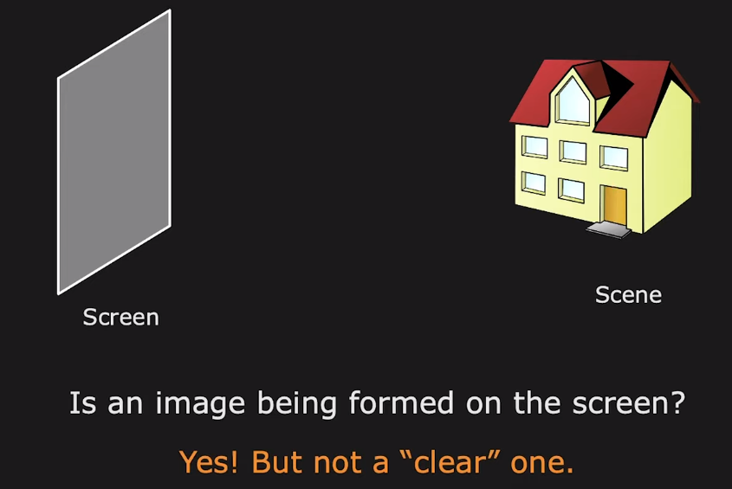
Image Formation

Slide 26
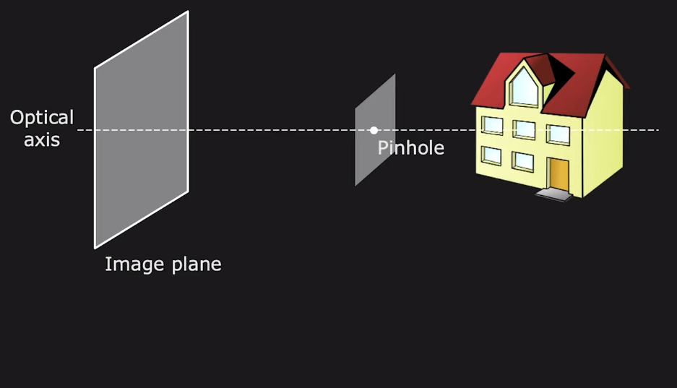
Perspective Imaging with Pinhole

Slide 27
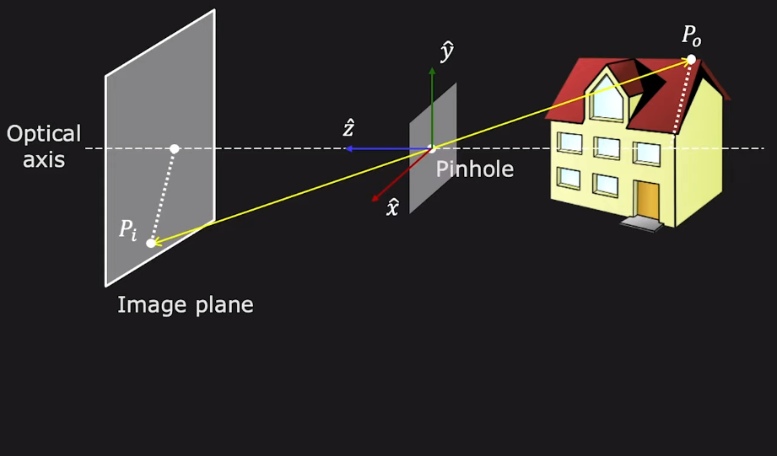
Perspective Imaging with Pinhole

Slide 28
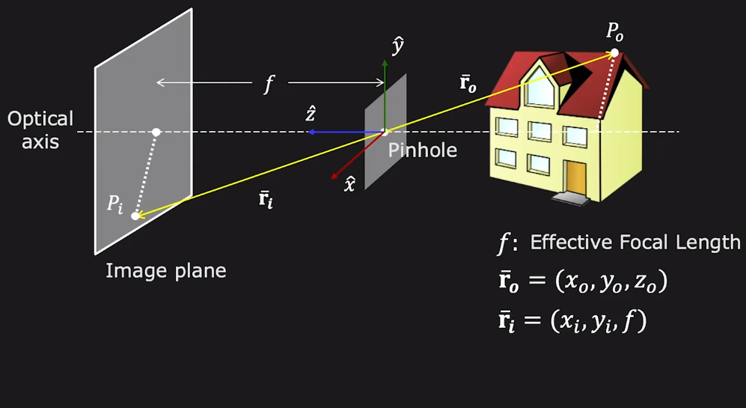
Perspective Imaging with Pinhole

Slide 29
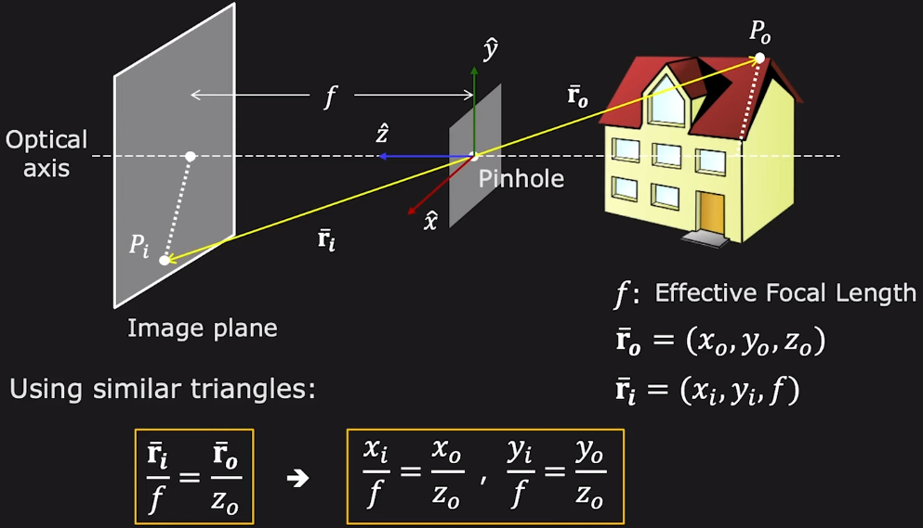
Perspective Imaging with Pinhole

Slide 30
Perspective Imaging with Pinhole

Slide 31
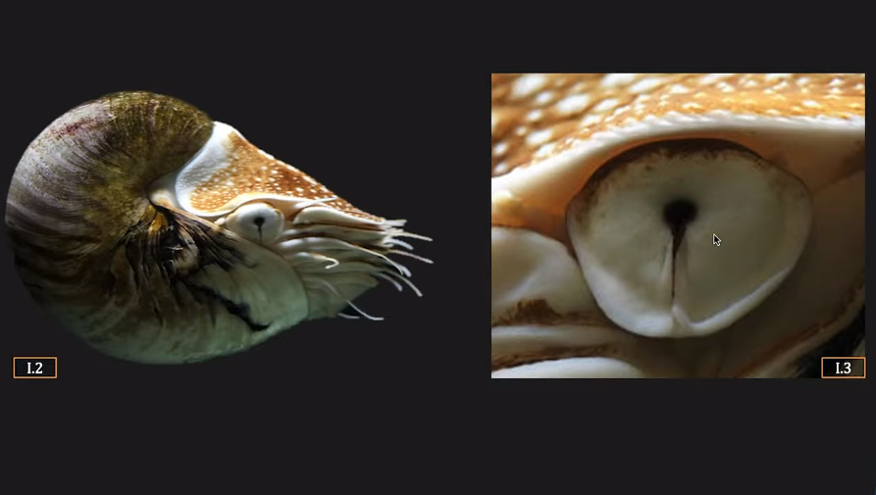
Pinhole Eye of Nautilus Pompilius

